Slide 1



Restaurant Recommender System
IBM Capstone Project
D. Vivek Nayudu

Slide 2


Restaurant RECOMMENDER SYSTEM
DATA
METHODOLOGY
DATA VISUALIZATION
RESULT & CONCLUSION

Slide 3
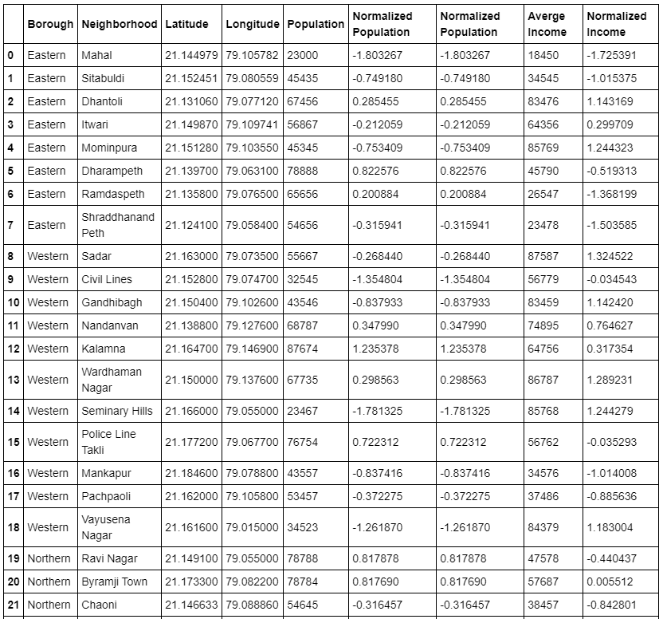
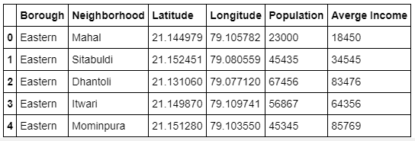
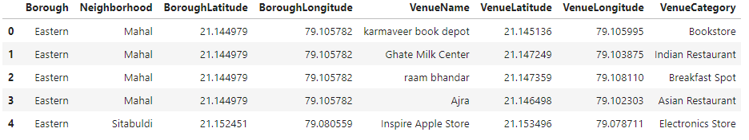
Data SETS

Slide 4
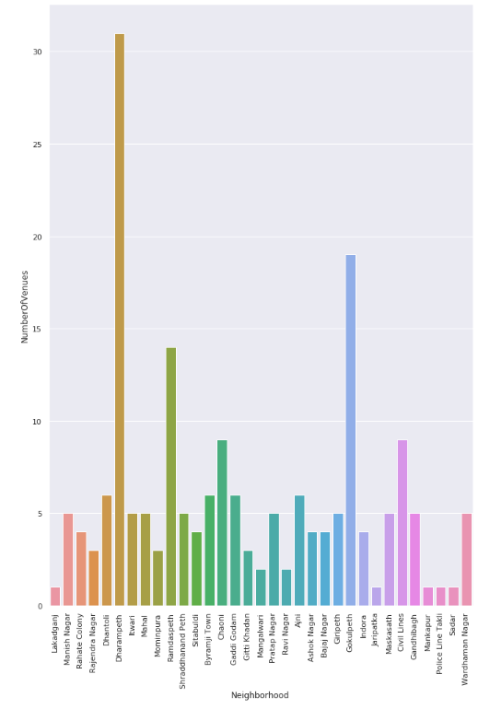
Methodology
Machine Learning
Exploratory Analysis
Recommender System
Inferential Analysis

Slide 5
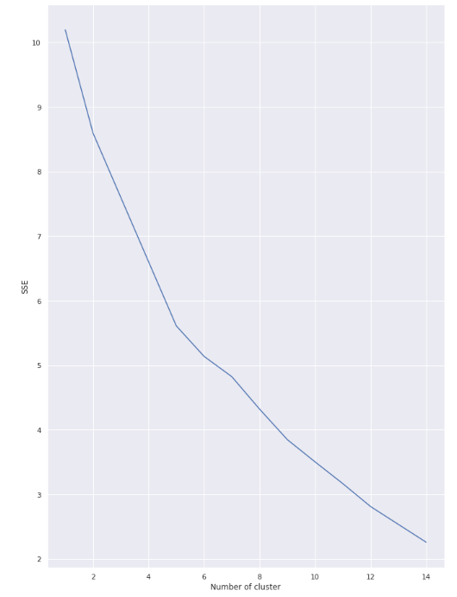
Methodology
Machine Learning
Exploratory Analysis
Recommender System
Inferential Analysis

Slide 6
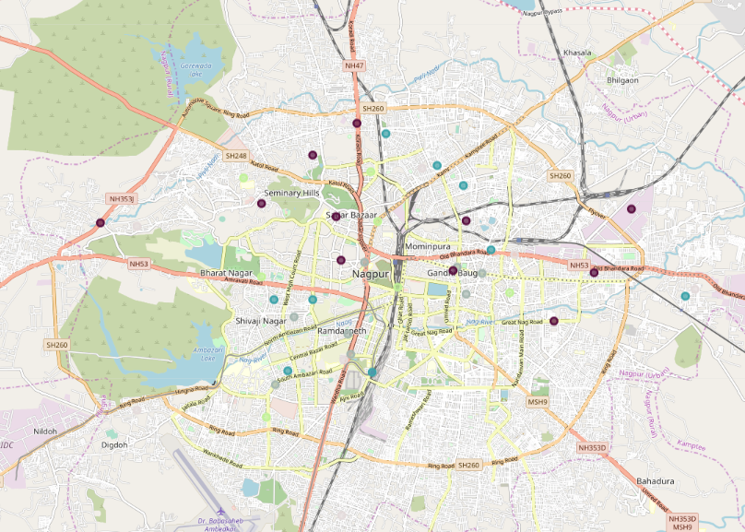
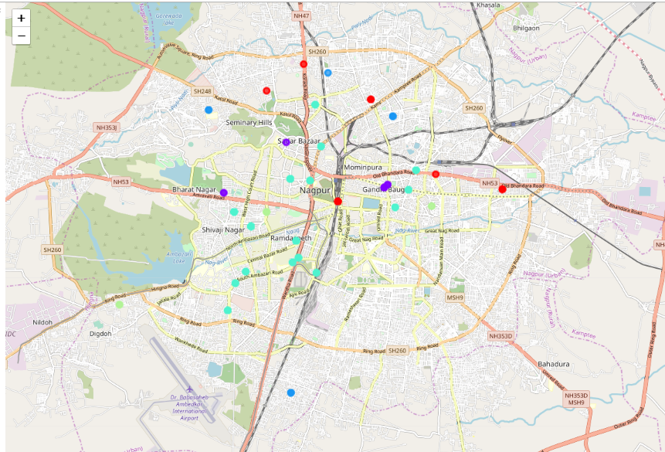
Mapping and Clustering

Slide 7
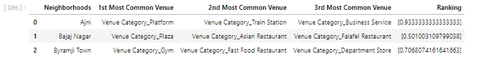
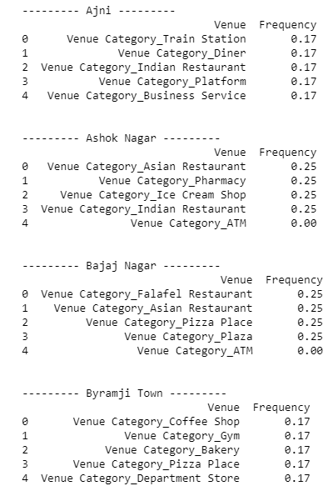
Result and conclusion
The recommender system is a system that considers factors such as population, income and makes use of Foursquare API to determine nearby venues.
It is a powerful data driven model whose efficiency may decrease with more data but accuracy will increase.
It will help users to finish their hunger by providing the best recommendation to fulfil all their needs.

Slide 8

Thank You

